Slide 1
CLOUDFRONT
- Velocity training institute
- SHANTANU MAHAJAN (SR ENGG DEVOPS)

Slide 2
WHAT IS cf?
Amazon cloud front is a global content delivery network service that accelerates delivery of your websites, API, video content or other web assets.
The major issues now a days with file or site access over the internet is latency, hence there is another layer of service added over your normal web app infra that is called CDN (connect delivery network)
CDN provider has multiple storage or you can say cache locations distributed all over the world, which help data/web-app access easy and fast with reduced latency.
Such CDN service is provided by Amazon with the help of Cloud Front.

Slide 3
CF Edge locations
CloudFront delivers your content through a worldwide network of data centers called edge locations. When a user requests content that you're serving with CloudFront, the request is routed to the edge location that provides the lowest latency (time delay), so that content is delivered with the best possible performance.
Amazon CloudFront uses a global network of 310+ Points of Presence (300+ Edge locations and 13 regional mid-tier caches) in 90+ cities across 47 countries.
https://aws.amazon.com/cloudfront/features/?whats-new-cloudfront.sort-by=item.additionalFields.postDateTime&whats-new-cloudfront.sort-order=desc

Slide 4
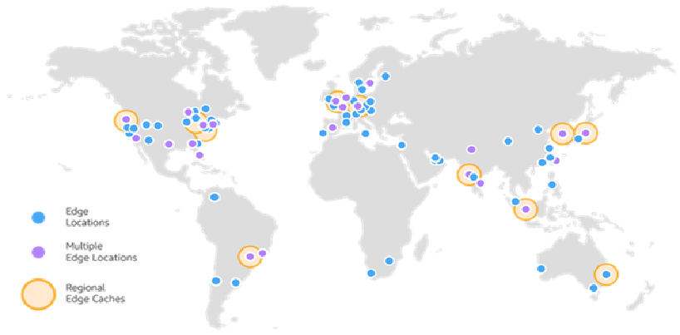
Cloud front edge locations

Slide 5
Regional edge cache
Regional Edge Caches have larger cache-width than any individual edge location, so your objects remain in cache longer at these locations.
This helps keep more of your content closer to your viewers, reducing the need for CloudFront to go back to your origin webserver, and improving overall performance for viewers

Slide 6
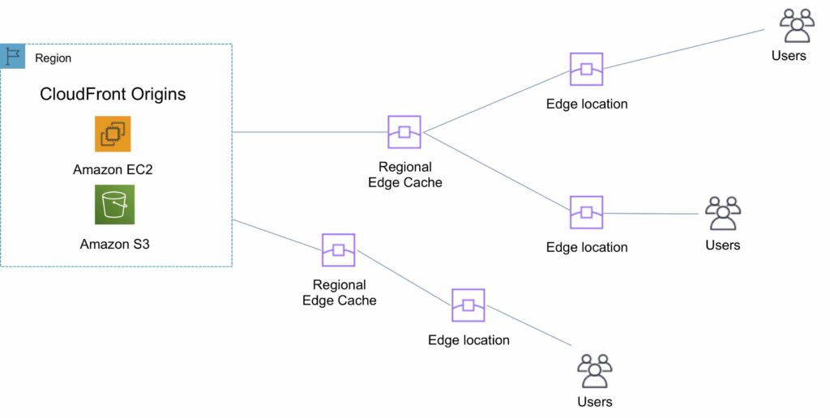

Slide 7
Features of CF
Can support both static and dynamic content
Supports PUT/POST and other http methods.
Can add custom SSL certificate.
Invalidation enabled.
We can add custom error Reponses.
Low TTL (time to live)
Geo targeting
Wildcard/zone apex certificate support

Slide 8
Some imp concepts of CF
TTL (Time to Live) :-
1. Time to live (TTL) is the time that an object is stored in a caching system before it’s deleted or refreshed.
2. Minimum TTL Specify the minimum amount of time, in seconds, that you want objects to stay in CloudFront caches before CloudFront forwards another request to your origin to determine whether the object has been updated.
3. The default value for Minimum TTL is 0 seconds. Maximum is 1year and default value is 1day. These values are specified in seconds.

Slide 9
Some imp concepts of CF
Invalidation:-
Amazon CloudFront's invalidation feature, which allows you to remove an object from the CloudFront cache before it expires.
To invalidate files, you can specify either the path for individual files or a path that ends with the * wildcard, which might apply to one file or to many, as shown in the following examples:
/images/image1.jpg
/images/image*
/images/*

Slide 10
Pricing and etc…
You incur CloudFront charges when CloudFront responds to requests for your objects.
https://aws.amazon.com/cloudfront/pricing/
How much load can CF cache server handle?
Amazon Cloud front can handle 250,000 requests per second per distribution. The data transfer rate per distribution is 150 Gbps, the maximum length of the request including headers, query strings is 20,480 bytes
The maximum size of a single file that can be delivered through Amazon CloudFront is 20 GB. This limit applies to all Amazon CloudFront distributions.
https://docs.aws.amazon.com/AmazonCloudFront/latest/DeveloperGuide/cloudfront-limits.html

Slide 11
Use cases
Accelerate static website content delivery. (S3 combined)
CloudFront can speed up the delivery of your static content to viewers across the globe.
https://aws.amazon.com/blogs/networking-and-content-delivery/amazon-s3-amazon-cloudfront-a-match-made-in-the-cloud/
Cloud front can be attached over the load balancer to reduce some load and latency.

